Slide 1
Insider Trading Problem
Nick Gallegos
Muntasir Al Kabir
Bear Nash

Slide 2
Presentation Overview
Data Sources: SEC Edgar Database, Yahoo Finance
Software: R, MS EXCEL,Tableau
Understand The Problem
Prepare Data
Identify Financial Earning Event
Identify Stock Event
Results
Improvements and Extensions
Identify Events

Slide 3
Statement of Purpose
Understanding the Problem
Prepare Data
Events
Develop a method using the SEC Edgar data base to identify environments in which insider trading can occur
Financial Earnings Event
Stock Market Event
Results
Improvements and Extensions

Slide 4
Insider Trading: Statistics (SEC)

Slide 5
Problem Layout
Understanding the Problem
Financial Earnings Report Event
Stock Market Event
Environment of Possible Insider Trading
Identify firms that have earnings reports outside of expected range
Prepare Data
Events
Financial Earnings Event
Stock Market Event
Results
Improvements and Extensions
Determine if selected firms also show unexpected movement in stock price

Slide 6
Prepare Data from the SEC Edgar Database
Understanding the Problem
Clean Data
Assess Data Quality
Aggregate / Reshape data
Prepare Data
Events
Financial Earnings Event
Stock Market Event
Results
Improvements and Extensions

Slide 7
Prepare Data: Full Data Set
Understanding the Problem
Prepare Data
Events
Financial Earnings Event
Stock Market Event
Results
Improvements and Extensions

Slide 8
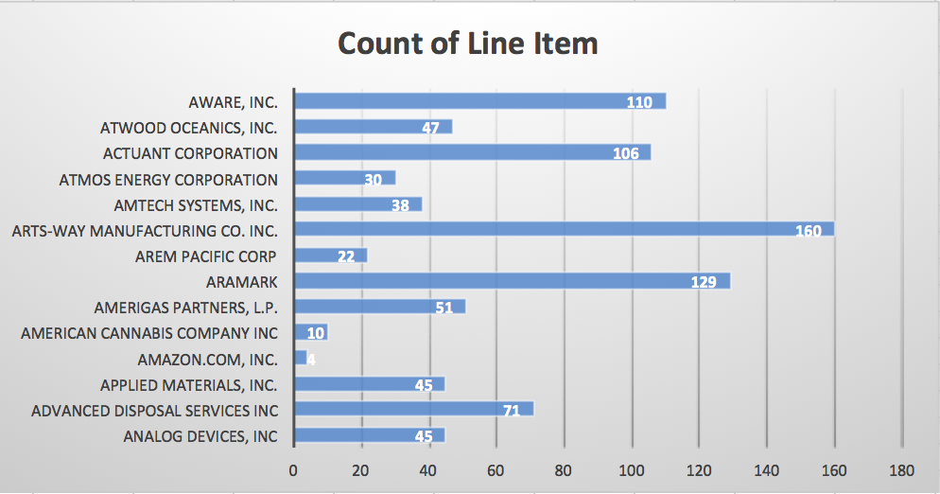
Prepare Data: Line Item Variation Example
Understanding the Problem
Prepare Data
Events
Financial Earnings Event
Stock Market Event
Results
Improvements and Extensions

Slide 9
Prepare Data : Summary
Understanding the Problem
45m observations, 32 quarters (2009-2016), 3846 of firms
14m observations, recent 8 quarters (2015-2016), 3001 firms
8k observations, 135 firms
250k observations, 2430 firms
Prepare Data
Take 8 quarters data
Events
Remove duplicate
Financial Earnings Event
Stock Market Event
Remove missing values
Results
Improvements and Extensions
Adsh | coreg | Ticker | tag | 2015Q1 | 2015Q2 | 2015Q3 | 2015Q4 | 2016Q1 | 2016Q2 | 2016Q3 | 2016Q4 | ReportDate
1047469 | NA | ADSW | InterestExpense | 3.50E+07 | 7.10E+07 | 1.04E+08 | 18757000 | 7645000 | 6.20E+07 | 9.30E+07 | 19336000 | 20161031
1047469 | NA | ADSW | SalesRevenueNet | 2.01E+09 | 6.13E+09 | 162830000 | 2390875000 | 825662000 | 5.79E+09 | 8.91E+09 | 2392175000 | 20161031
1047469 | NA | ADSW | SellingGeneralAndAdministrativeExpense | 3.07E+09 | 6.13E+09 | 9.10E+09 | 536821000 | 2.00E+09 | 2.04E+09 | 1.07E+09 | 540199000 | 20161031
1062993 | NA | TMQ | CashAndCashEquivalentsPeriodIncreaseDecrease | -10204000 | 3492534 | 2446491 | -803965 | -24193000 | -1476118 | -2011519 | 275427 | 20160831
1062993 | NA | TMQ | Depreciation | 25293 | 51803 | 76631 | 106280 | 23212 | 45835 | 67801 | 619 | 20160831

Slide 10


Understanding the Problem
Prepare Data
Events
Financial Earnings Event
Stock Market Event
Results
Improvements and Extensions

Slide 11
Event Identification Process
Financial Earnings Event
Stock Market Event
SEC data for 135 firms over 8 quarters
Firms with highest proportion of line items outside forecasted range are identified
Identify firms showing unexpected stock price movement
Connect identified firms with stock market data at time of earnings report
Methods
Results
R Holt Winters Forecast
6 firms identified
Use data from 7 previous quarters to forecast quarter 4, 2016
Bollinger Band Forecast
4 firms identified
Metrics:
Bollinger Bands
Moving Averages
S&P 500 Overlay
Excel Forecast
10 firms identified

Slide 12

Financial Earnings Event

Slide 13
Financial Earnings Event: Process
Understanding the Problem
Forecast line items for 135 firms
Prepare Data
Events
Create 95% confidence interval
Financial Earnings Event
Stock Market Event
Ratio of line items outside of confidence interval to total line items
Is actual value within forecasted range???
Results
NO
YES
Improvements and Extensions
NO
YES + NO
Firms with highest ratio are identified
Look to Stock Market

Slide 14
Financial Earning Event: Line Item Forecast Example
Understanding the Problem
Prepare Data
Events
Financial Earnings Event
Stock Market Event
Summary
Improvements and Extensions

Slide 15
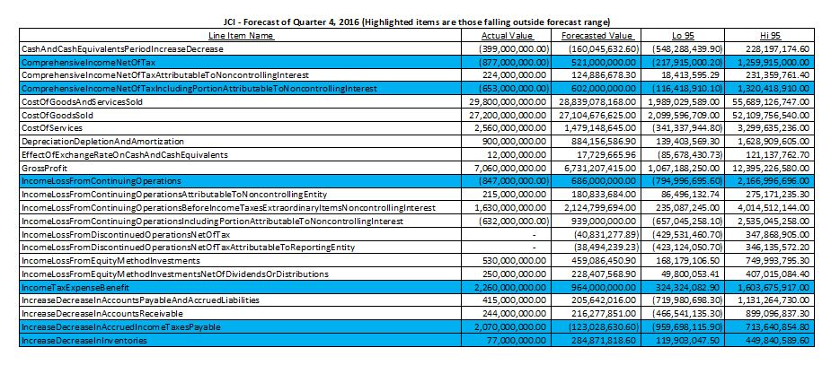
Financial Earning Event: Johnson Controls Example
Understanding the Problem
Prepare Data
Events
Financial Earnings Event
Stock Market Event
Summary
Improvements and Extensions

Slide 16
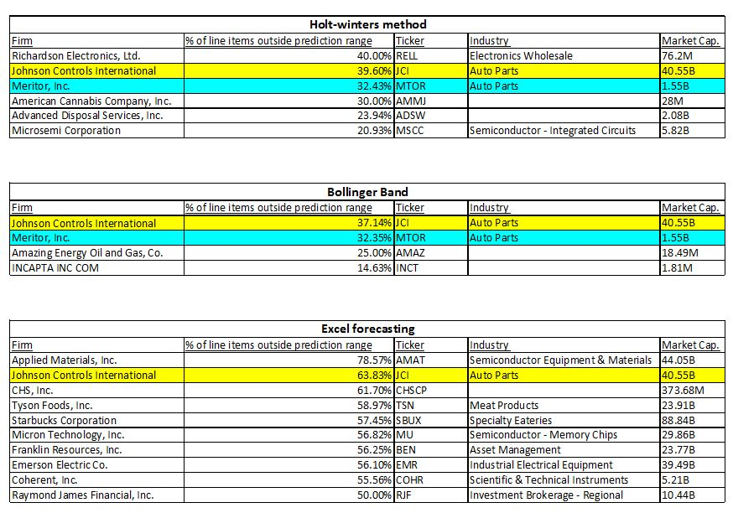
Financial Earning Event: Forecast Results
Understanding the Problem
Prepare Data
Events
Financial Earnings Event
Stock Market Event
Summary
Improvements and Extensions

Slide 17

Stock Market Event

Slide 18
Stock Market Event: Process
Understanding the Problem
Prepare Data
18 firms identified by three different forecasts of earnings report data
Events
Financial Earnings Event
Find exact earnings report date for each firm
Metrics
Stock Market Event
Get stock market data from Yahoo Finance
S&P 500 Relativity
Summary
Moving Average
Improvements and Extensions
Bollinger Band
Identify group of firms exhibiting stock market event

Slide 19
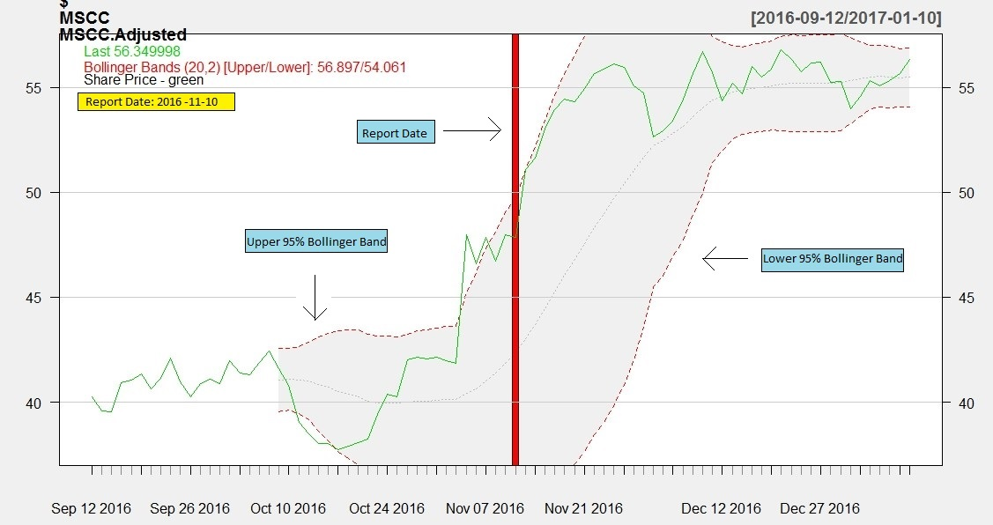
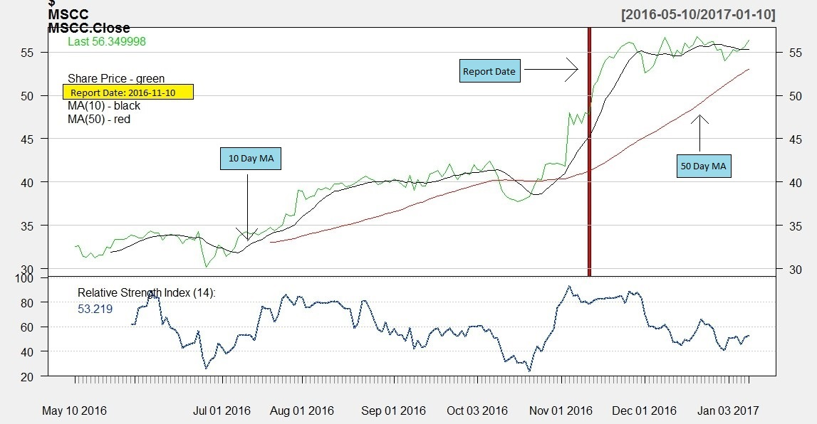
Stock Market Event: Positive Event Example (Microsemi Corporation)
Understanding the Problem
Bollinger Bands Moving Averages
Prepare Data
Events
Financial Earnings Event
Stock Market Event
Summary
Improvements and Extensions

Slide 20
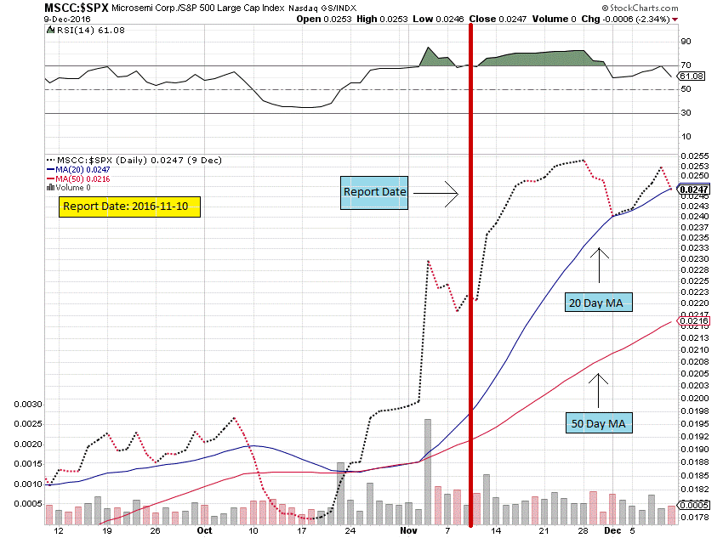
Stock Market Event: Positive Event Example (Microsemi Corporation)
Understanding the Problem
S&P 500 Overlay
Prepare Data
Events
Financial Earnings Event
Stock Market Event
Summary
Improvements and Extensions

Slide 21
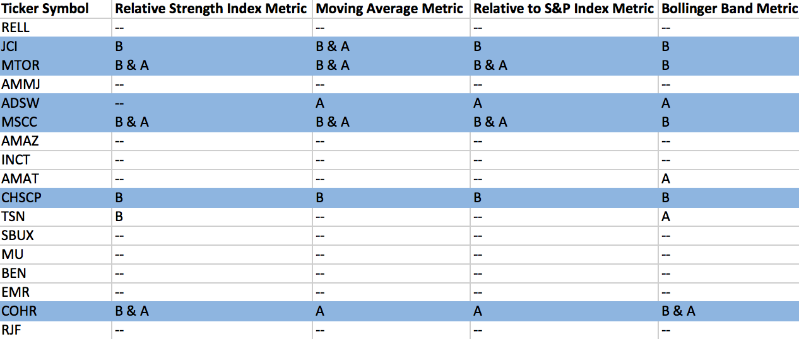
Stock Market Event Summary
Understanding the Problem
Prepare Data
Events
Financial Earnings Event
Stock Market Event
Summary
Improvements and Extensions
B – Before Earnings Release A – After Earnings Release

Slide 22
Summary
Understanding the Problem
JCI was identified by all three methods. MTOR by two methods
Prepare Data
Started with 14m line items and 3001 firms for 8 quarters
Narrowed to 8k line items and 135 firms
Identified 18 firms with 3 forecast methods of financial earnings
Events
Financial Earnings Event
Stock Market Event
Summary
Challenges with data quality and consistency of reporting between firms
Of those 18 firms, 6 were identified for the stock market event
6 firms exhibit an environment of possible insider trading
Improvements and Extensions

Slide 23
Improvements & Project Extensions
Understanding the Problem
Value line items and determine how they will impact stock
Statistical quality test of financial earnings forecast
Better understand issues in the data
Double check strange values with actual earnings report
Isolate strange stock market activity and connect with individual trading accounts
Improve stock market event identification
Assess better method for finding report dates
Forecast for larger range of quarters and compare with current 8 quarter method
Find a method allowing use of larger portion of SEC data.
Simplifying and Improving the Process
Prepare Data
Add API’s to further analysis
Automate data import and data cleaning
Consider another forecasting method to compare against
Events
Financial Earnings Event
Stock Market Event
Summary
Improvements and Extensions
Incorporating other factors
Social media sentiment
Analyst opinions
Morning star ratings
Comparison with industry specifics ETF performance
Consider firm size in financial event forecast

Slide 24

Questions

Slide 25
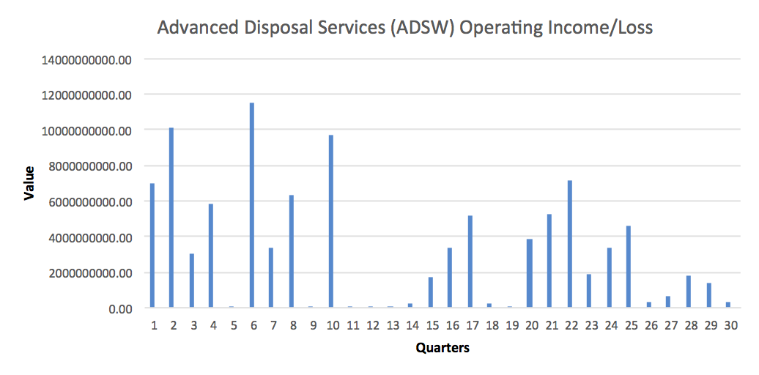
Recent Data Better Than Old

Slide 26
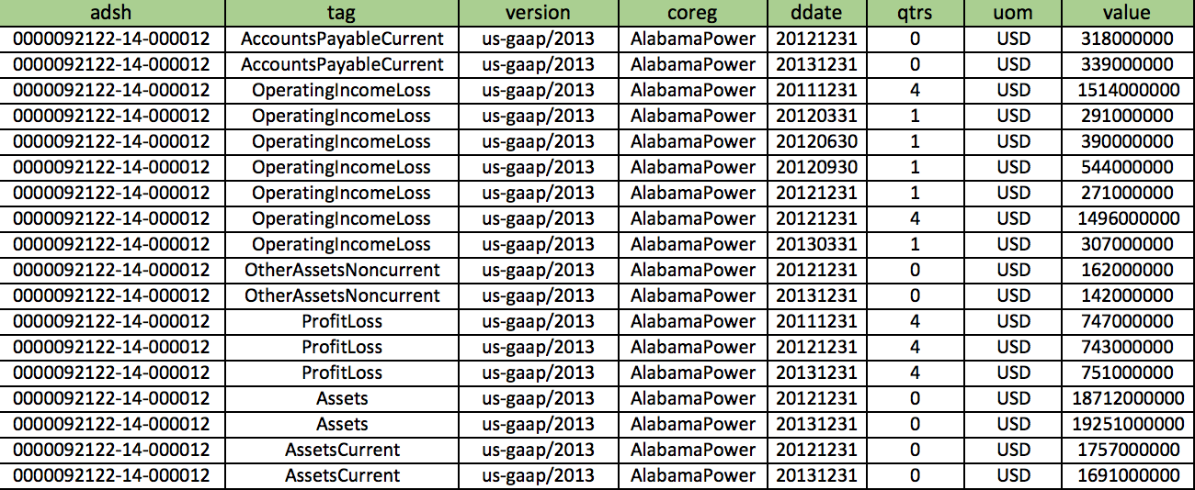
SEC Data: Raw Data Example
Understanding the Problem
Prepare Data
Events
Financial Earnings Event
Stock Market Event
Results
Improvements and Extensions

Slide 27
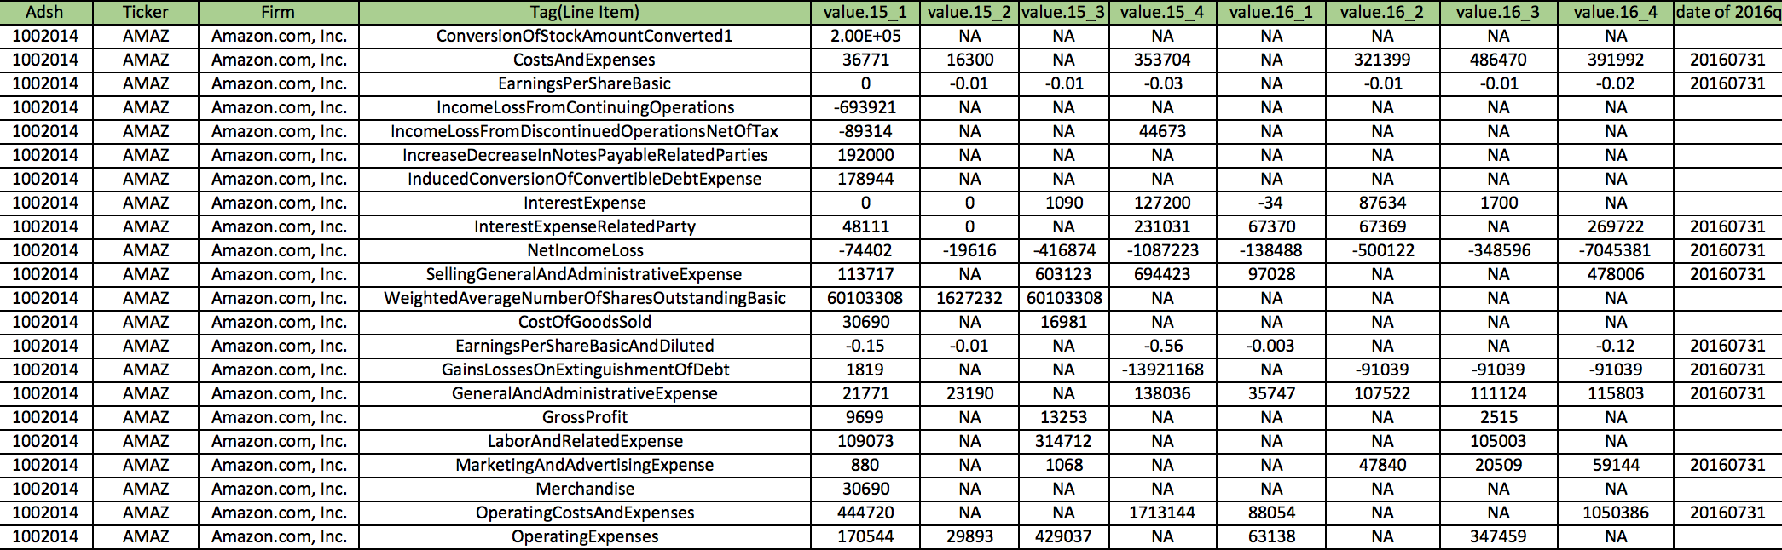
SEC Data: Missing Value Example
Understanding the Problem
Prepare Data
Events
Financial Earnings Event
Stock Market Event
Results
Improvements and Extensions
Notes:
Add data examples

